Slide 1

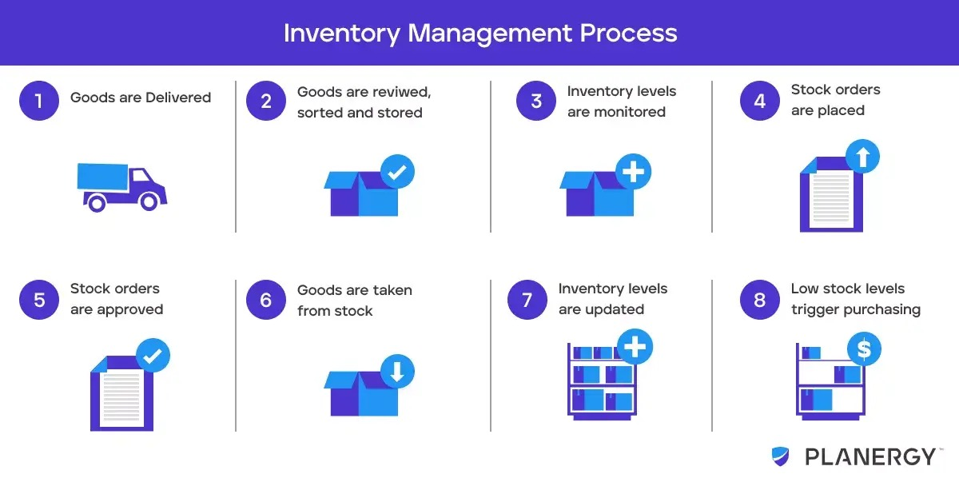
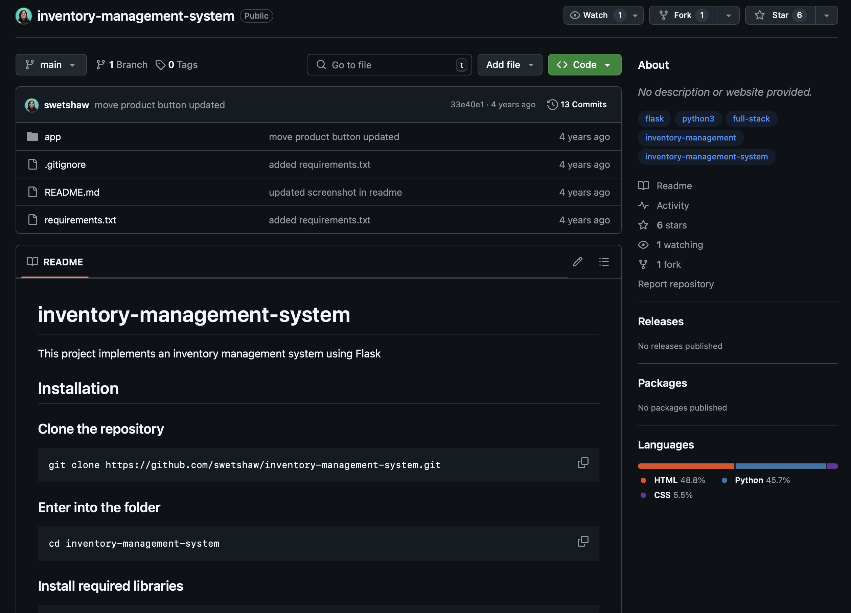


Smart Inventory Management for a Small Business
By: Farihah Awan
Main Concept (Tag Line)
"Making inventory effortless by tracking, restock, and optimizing in real time."

